Slide 1
Knowledge Byte
  In this section, you will learn about:
    Object-Oriented Analysis and Design
    Various Types of Inheritance
    Abstract Classes and Methods

Slide 2
Object-Oriented Analysis and Design
  Consists of object-oriented analysis and object-oriented design.
  In object-oriented analysis, the end users and the developers of the system analyze the requirements of the new system.
  The Software Development Life Cycle (SDLC) is a set of phases that divides the entire process of building a large program or application into smaller and more manageable units.

Slide 3
Object-Oriented Analysis and
Design(Contd.)
  A stage of the SDLC consists of well-defined activities and methods needed to perform various tasks, such as:
    Collecting information about the software that needs to be developed
    Documenting the retrieved information
    Creating design documents
    Implementing and coding the software
    Testing the software
    Deploying the software

Slide 4
Object-Oriented Analysis and
Design(Contd.)
  The four phases of SDLC are:
    Inception
    Elaboration
    Construction
    Transition

Slide 5
Object-Oriented Analysis and
Design(Contd.)
    Inception
      This is the first phase of the SDLC process.
        Understanding the problem and the methods for solving it.
        Specifying the scope, objectives, and requirements of the software system.
        Specifying the estimates of the resources needed.
        Planning a schedule of the various stages in the project.

Slide 6
Object-Oriented Analysis and
Design(Contd.)
    Elaboration
      This is the second phase of the SDLC process.
        Elaborating the system specification obtained from the inception phase
        Analyzing the problem
        Describing the system’s requirements by creating a model of the system
        Analyzing the requirements for the project
        Developing the project plan

Slide 7
Object-Oriented Analysis and
Design(Contd.)
    Construction
      This is the third phase of the SDLC process.
        Elaborating the solution specification obtained from the elaboration phase
        Building and developing the software system
        Completing implementation and testing of the software system
        Analyzing the requirements for the project
        Extending the functions of the system based on test results

Slide 8
Object-Oriented Analysis and
Design(Contd.)
    Transition
      This is the last phase of the SDLC process
        Integrating different modules
        Delivering the integrated modules
        Deploying the integrated modules
        Correcting problems in the deployed modules

Slide 9
Object-Oriented Analysis and
Design(Contd.)
  Various Types of Inheritance
    Multilevel
    Hybrid
    Hierarchical
    Multipath

Slide 10
Object-Oriented Analysis and
Design(Contd.)
    Multilevel Inheritance
      A class is derived from an inherited class.
Class A
Parent Class for Class B
Class B
Parent Class for Class C
Class C

Slide 11
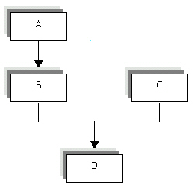
Object-Oriented Analysis and
Design(Contd.)
    Hybrid Inheritance
      A derived class exhibits two or more than two types of inheritance.

Slide 12
Object-Oriented Analysis and
Design(Contd.)
    Hierarchical Inheritance
      More than one subclass can be derived from a single base class.
Class A
Parent Class for Classes B, C, and D
Class B
Class C
Class D

Slide 13
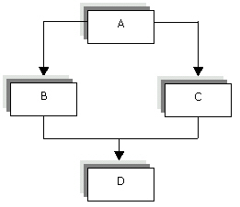
Object-Oriented Analysis and
Design(Contd.)
    Multipath Inheritance
      Combination of multiple and hierarchical inheritance .

Slide 14
Object-Oriented Analysis and
Design(Contd.)
  Abstract Classes and Methods
    A class that cannot be instantiated.
    Contains methods that have no implementation.

Slide 15
From the Expert’s Desk
  In this section, you will look at some FAQs on OOPs.

Slide 16
FAQs
  What are the examples of the object-oriented programming languages?
  The examples of the object-oriented programming languages are: Simula, C++, Python, Smalltalk, CLOS, and Java.
  What are the primary object-oriented methodologies used currently?
  The primary object-oriented methodologies are: BON, FUSION, HOOD, IBM, and UML.

Slide 17
FAQs (Contd.)
  How did object-orientation evolve?
  The object-orientation evolved with the evolution of Simula that provided features, such as objects, classes, and inheritance. Simula was the first object-oriented programming language. Simula 1 was a simulation language and Simula 67 was referred as Simula. Smalltalk was another language having various features, such as classes, inheritance, and graphical user environment.

Slide 18

FAQs (Contd.)
  Class B inherits features from its base class, class A. Class C is a sub class of class B and inherits features from class B. How many times will the features of class A appear in class C?
  The following figure shows the class hierarchy for classes A, B, and C.
  Class B inherits features from its base class, Class A. These features occur only once in Class B. Class C inherits features from its base class, Class B. The features inherited by Class C include the features that Class B inherited from Class A. Therefore, the features of Class A appear only once in Class C.

Slide 19
Challenge
Match the following:
  Java i. Structured Programming Language
  Pascal ii. Procedural Programming Language
  C iii. Object Oriented Programming
  LISP iv. Imperative Programming Language
  FORTRAN v. Functional Programming Language

Slide 20
Challenge(Contd.)
Make words from the jumbled letters in the box given below and match them with their description :
  An object is an_______ of a class
  The attribute of a class is represented by _________.
  ________ feature of object-oriented programming is also called information hiding.
  An object of class has a unique________.
  A _____ class is not instantiated.
Canniest
Tdaa bmreem
Noitaluspacne
Entiityd
srctaabt

Slide 21
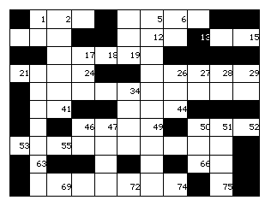
Challenge(Contd.)
  Solve the following crossword:

Slide 22
Challenge(Contd.)
  Across:
  34 Type of Inheritance in which there is one base class and one sub class (6)
  55 The characteristic of an object that refers to a change of the state of the object over a period of time (8)
  69 ________is an example of procedural programming (5)
  Down:
  2 A program that can be divided into small user-defined units(6)
  5 The type of inheritance in which there is more than on level of
  inheritance. (10)

Slide 23
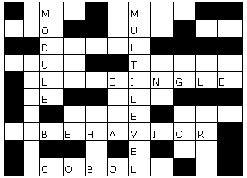
Solutions to Challenge
  a-iii, b-ii, c-i, d-v, e-iv
  A. instance, b. data member, c. encapsulation, d. identity, e. abstract
  Across: 34 Single, 55 Behavior, 69 COBOL
  Down: 2 Module, 5 Multilevel

